Slide 1

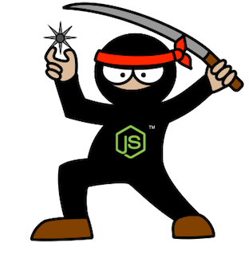
Supersize Node.js –
M&E Cloud Service Journey
Guillaume Brossard
David Richer
Sr. Engineer – M&E Cloud Services
Sr. Engineer – M&E Cloud Services
Notes:
V1.0

Slide 2

M&E Cloud Services - Context
Open the Cloud to Artists and Managers
Multi-segment team, using a Core Services stack
Notes:
January 2013, M&E Cloud Services
Our mission:
Open the Cloud to Artists and Managers using M&E products
Empower our users with collaboration features
The Product:
Multi-segment team
In-DCC integration
Tray Application
Specialized Web Services
Core stack for inter-operability
Challenge:
Build a deployment process flexible enough to support deployment of a multi-segment product.
None of the products where precisely defined initially

Slide 3
Deployment Goals
Easy deployment
Deployment as code
Small pieces to build something big
“Developer-centric” environment
Development to be deployment agnostic
Notes:
Easy Deployment
Sync and run script
Deployment as code
Sync branch and deploy (source control)
Small pieces to build something big
“Developer-centric” environment
Development to be deployment agnostic

Slide 4
Architecture Oversight
Notes:
At the beginning, we didn’t knew much about the final architecture of the system.
What we knew
The stack would be composed of many services.
Services would need to be scalable.
Configuration would change regularly.
From deploying services, our mind set changed to deploying a set of instances, playing one or many roles
Dynamic Layouting of Roles

Slide 5
Architecture How Node.js Tinted the Architecture
Notes:
Another thing we knew from the start was that our stack would be build around Node.js
How does Node.js tinted the architecture:
Not much dependencies
Encourage development of small services
Reusable modules
Web Storage (npm registry, Git)

Slide 6
Architecture Amazon
Notes:
The third fixed variable in our setup was that the stack would be deployed on Amazon.
What a great news. Amazon offers a multitude of tools that makes developers life easier:
Deployment
Cloud Formation
Scaling
Elastic Load Balancers
Auto-Scaling Groups
Security
Private stack
Services vs. DB Stack
DNSing
Route 53
NAT Instance

Slide 7
Deployment as code
Everything in source control
Sync and deploy
Use a different repository from the code
Branch and tag in deployment repository
Notes:
Everything in source control
Sync and deploy
Use a different repository from the code
Code and deployment don’t evolve at the same speed
Branch and tag in deployment repository
Release management like for the code

Slide 8
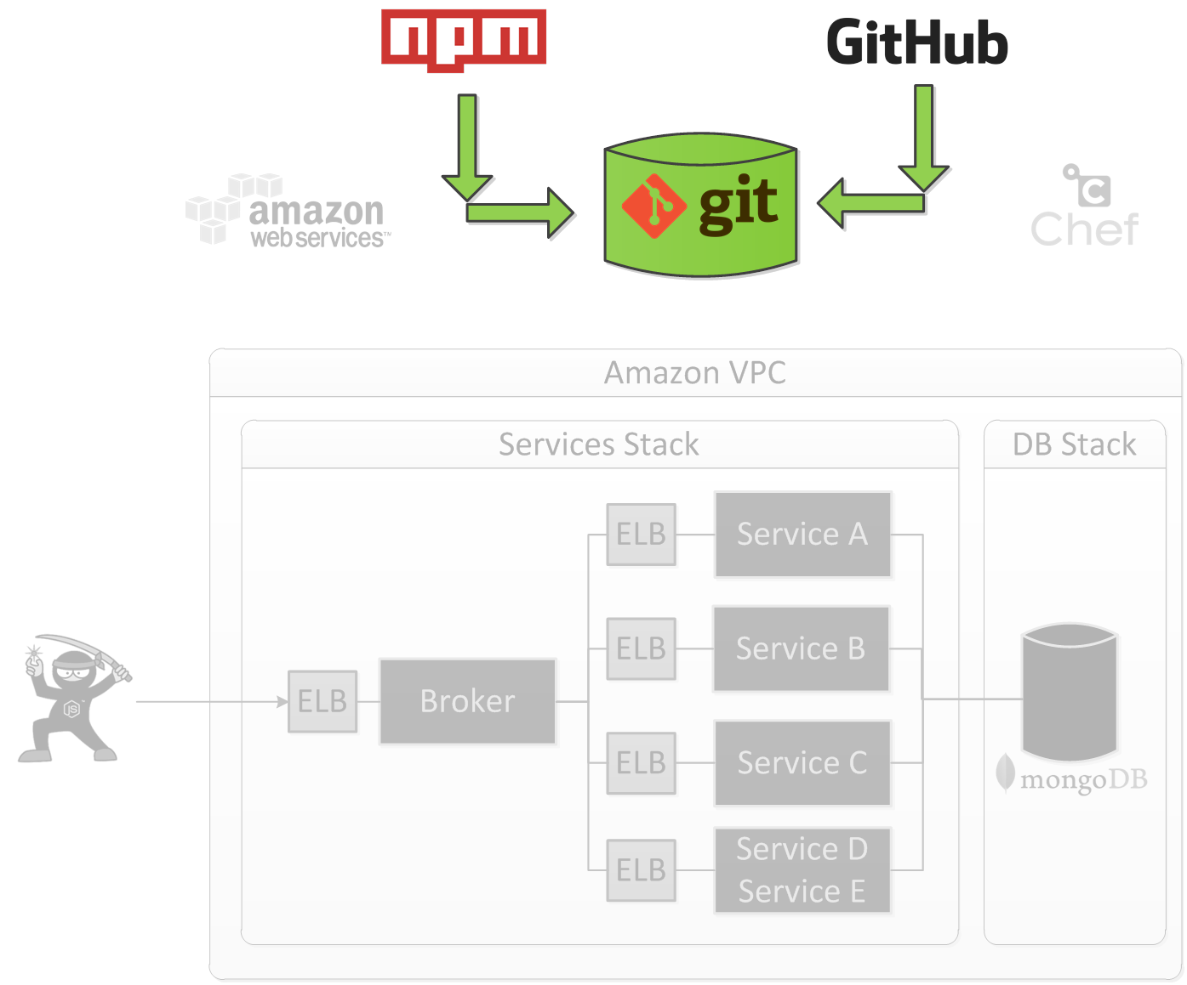
Publish
Notes:
Introduction
Create a package ready for deployment
Break dependency from npm registry and git Autodesk
Faster to deploy

Slide 9
Publish
Notes:
Install
Install module from npm registry
Install module from Autodesk private git repository
Publish
Gitolite
Node.js Modules
Decoupling from npm registry and git
Deploy

Slide 10
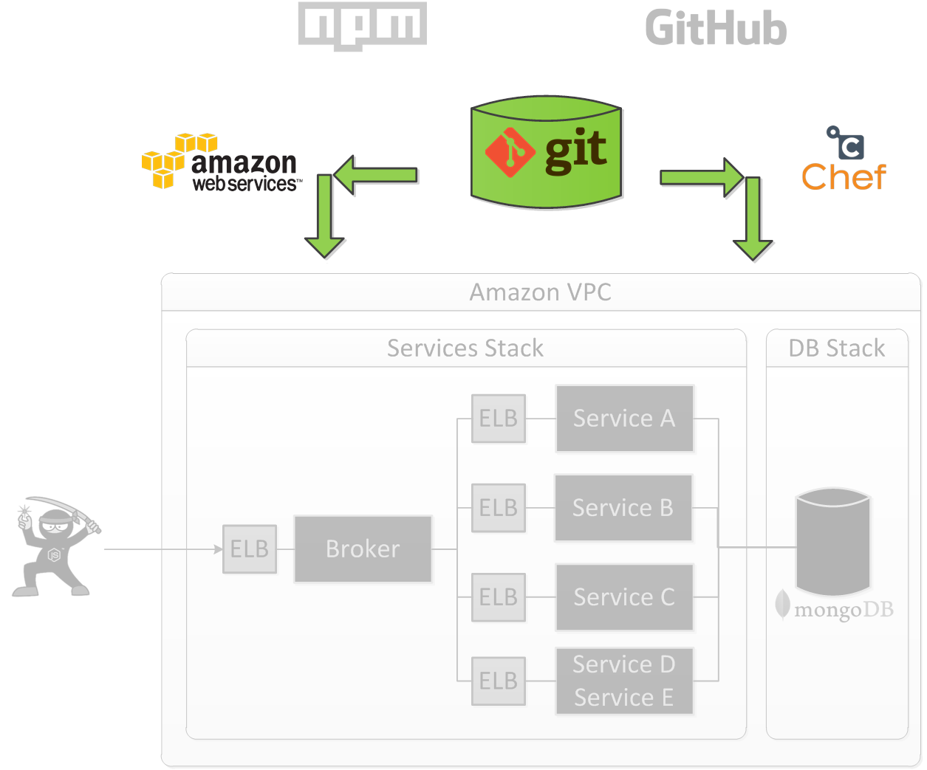
Provisioning

Slide 11
Cloud Formation
JSON file
Template generation
Create and delete stack
Update existing stack
Notes:
JSON File
Describe all resources in the stack
Template generation
A need for a simpler representation with less duplication
Create and delete stack
Easy stack management
Update existing stack
Amazing capability to analyze the difference and only update needed resource
Talk about rolling update for AutoScaling group

Slide 12


Provisioning
Roles and Chef
Upstart
Vagrant
Notes:
Definition of the provisioning a machine
Configure a vanilla Linux machine to be ready to operate
Roles and Chef
-
Upstart
- Helpful ubuntu tools to start and monitor a process. Restart node process ready fast after a crash.
Vagrant
Great way to quickly test Chef cookbooks
We had greater plan for Vagrant usage at the beginning but we only use it to test cookbooks.

Slide 13
Provisioning - Chronology
Notes:
Steps from a vanilla Ubuntu image to a machine running our service
Image
We choose to not start from a baked image because the provisioning time is still low 5 minutes.
We see image generation as an optimization.

Slide 14
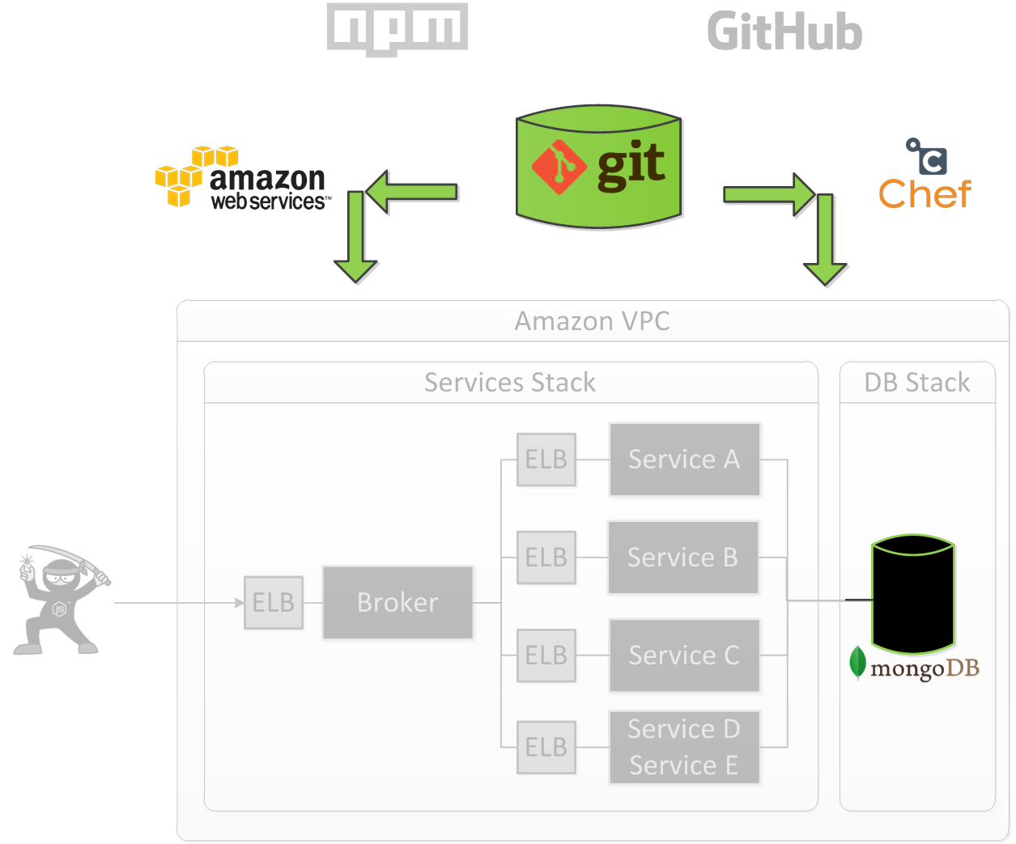
Provisioning - MongoDB
Notes:
Main Data Store is MongoDB
PostgreSQL on RDS for the mapping service

Slide 15
MongoDB – Replica Set
Notes:
Introduction to our MongoDB setup
We use a replica set, will use sharding in the future when it will ne needed.
We use three machines in different Amazon Availability zone
We do the database backup by doing a EBS snapshot of one of the secondary machine
For the logging database, no need for replica set or backup, not system critical but still annoying.

Slide 16
MongoDB – Chronology
Notes:
Provision Secondaries
Install Mongo
Start Mongo
Provision Primary
Install Mongo
Restore Snapshot
- We start from an EBS Snapshot
Initialize Replica Set
Elect a new master, always the same
Data replication from master to both secondary
Data Migration
- Run a node.js application to upgrade the data as needed.
Provision Service Stack
Comments
- Room for optimization take 30 minutes to be ready

Slide 17
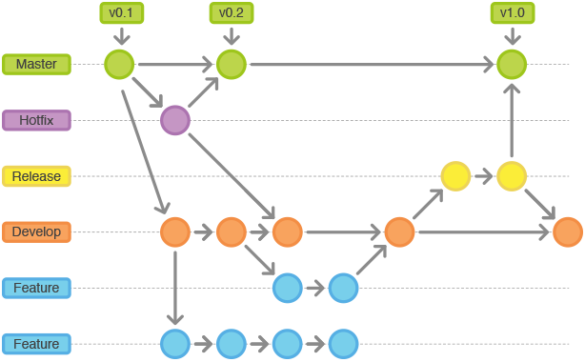
From Development to Production

Slide 18
Stack Family
Notes:
Stack family is a represented by a URL, the data evolve over time.
Each stack family has his own data, this allow to properly test data migration.
Seems obvious; but we delayed it a bit and it causes us issues.

Slide 19
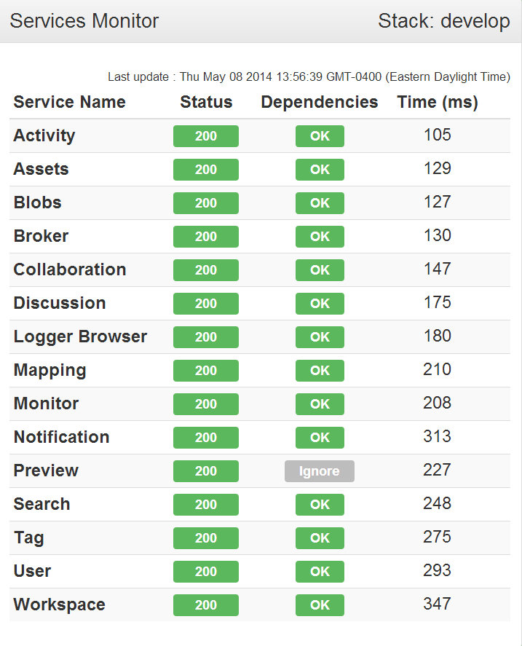
Stack Monitoring
Sys Admin Portal
Monitor Page
Logs
Tracing
Notes:
Introduction
Need to know the state of the stack and what happens in the past.
Monitor page should the individual status of each services and his dependencies.

Slide 20
Logs Architecture
Notes:
We use rabbitMQ queue to control the flow of logs message in case of huge spikes.

Slide 21
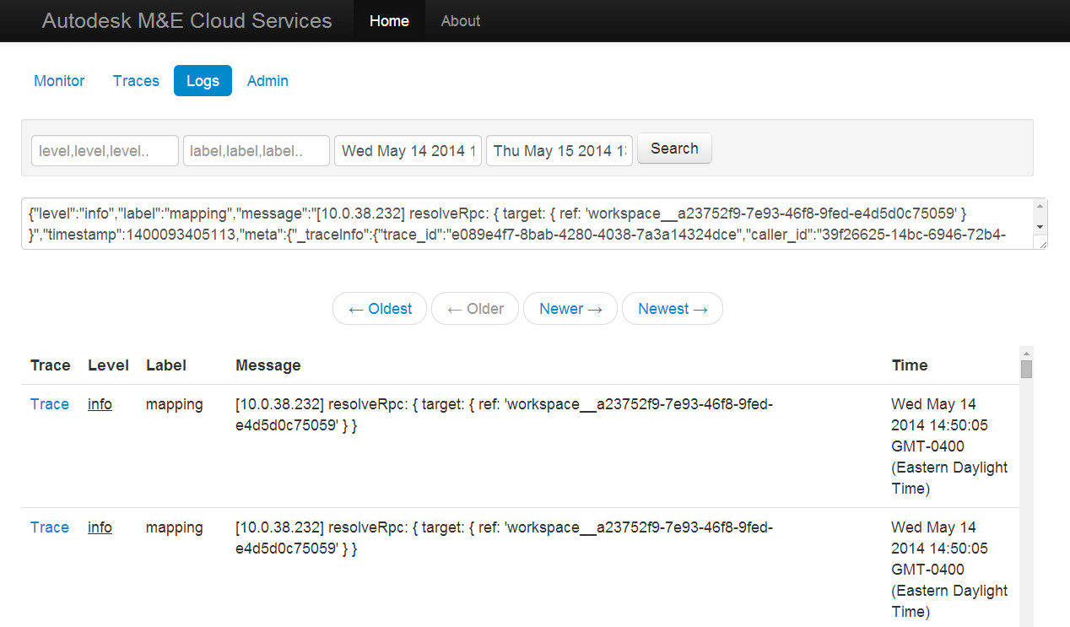
Logs

Slide 22
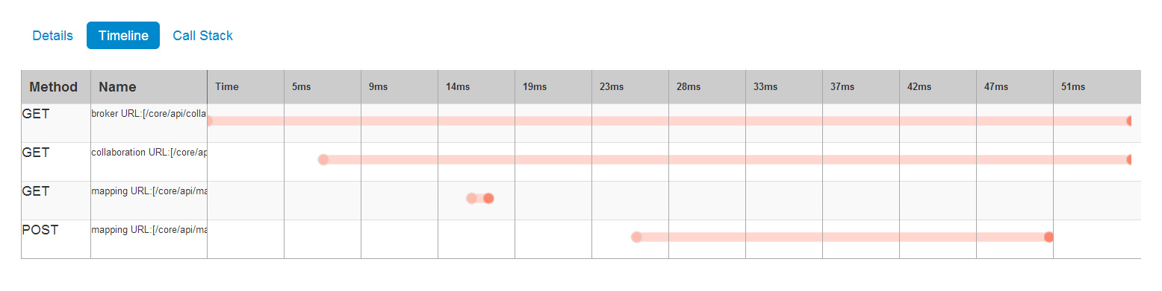
Tracing

Slide 23
Stack Diagnostic and Debugging
Access the stack using ssh
Scripts
Tunnel to any instance
Tunnel to MongoDB using RoboMongo
Node.js remote debugging
Notes:
Access the stack using ssh
Scripts

Slide 24
Lessons Learned The Good Parts
Shared Configuration (nconf)
Deployment from day 1
Investment in development/deployment tools
“Local” Deployment
Notes:
Shared Configuration (nconf)
Deployment from day 1
Investment in development
“Local” Deployment
Vagrant
Cross-platform technology
“Full” JavaScript stack

Slide 25
Lessons Learned The Bad Parts
Chef Server
Cloud Formation Abstraction
Npm registry
Notes:
Chef Server
Complex
Not used at its full potential as other tools gave us the same feature set
Consider packer (with chef solo only)
Cloud Formation template generation abstraction
We identify correctly the issue
Mustache not the right tool to do that
Npm registry
Correctly decoupled deployment from npm registry
Git protocol for node modules works, but it is slow + not reliable
Fetching from npm is not fast
Private npm registry would be preferable
Middle-ground solution with npm lazy, workspace

